Slide 1
Machine Learning – Introduction to deep learning
Srini Karlekar – Multifamily architecture

Slide 2
Agenda
Machine Learning – A Gentle Introduction
Traditional Programming vs Machine Learning
Applicability of Machine Learning
Deep Learning – Neural Networks
Feed Forward Neural Network
How does the Neural Network Learn?
Loss Functions & Optimizers
Building a Single Neuron Neural Network
Simple Neural Network for House Price Prediction
Tinker with a Live Neural Network
Feature Engineering
Overfitting in Deep Learning
Regularization in Deep Learning
Deep Learning – Image Recognition with Neural Network
Classifying Images of Cats and Dogs

Slide 3
Machine learning
A gentle introduction

Slide 4
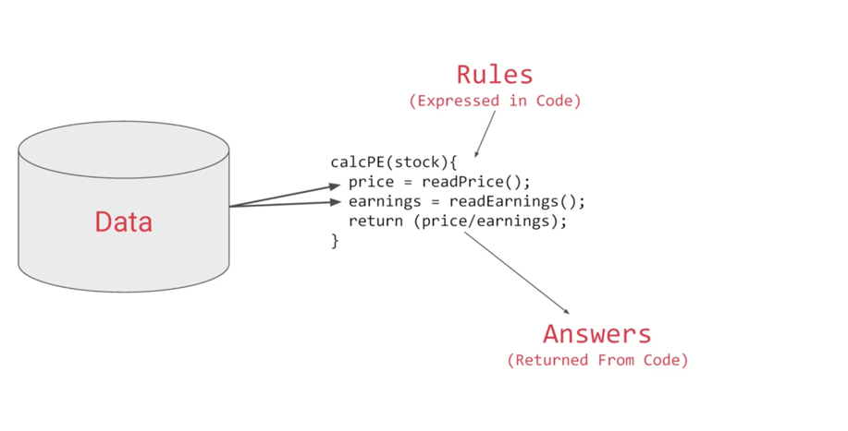
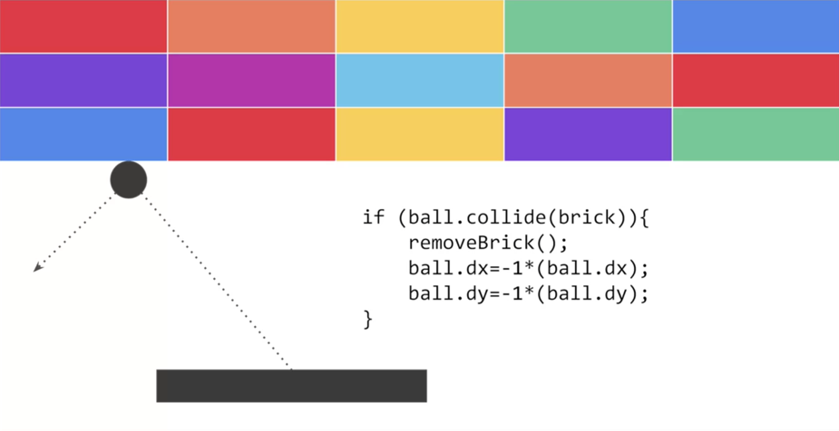
Traditional Programming - Examples
Stock Analytics
Gaming
Notes:
We're used to creating applications by breaking down requirements into composable problems that can then be coded against. So for example, if we have to write an application that figures out a stock analytic, maybe the price divided by the ratio, we can usually write code to get the values from a data source, do the calculation and then return the result. Or if we're writing a game we can usually figure out the rules. For example, if the ball hits the brick then the brick should vanish and the ball should rebound. But if the ball falls off the bottom of the screen then maybe the player loses their life.

Slide 5
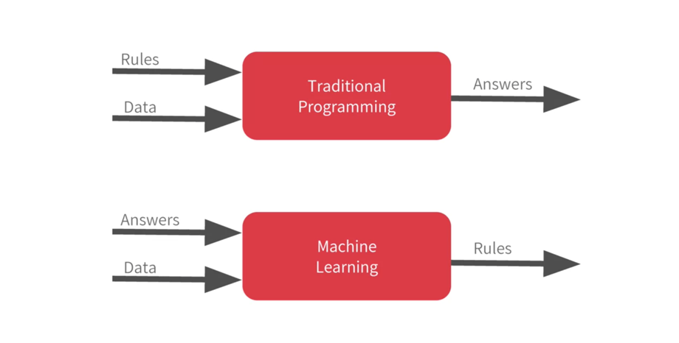
Traditional Programming vs machine learning
So when & where is machine learning useful?
Notes:
We can represent that with this diagram. Rules and data go in answers come out. Rules are expressed in a programming language and data can come from a variety of sources from local variables all the way up to databases.
Machine learning rearranges this paradigm where we put answers in data in and then we get rules out. So instead of us as developers figuring out the rules when should the brick be removed, when should the player's life end, or what's the desired analytic for a stock, what we will do is we can get a bunch of examples for what we want to see and then have the computer figure out the rules.

Slide 6
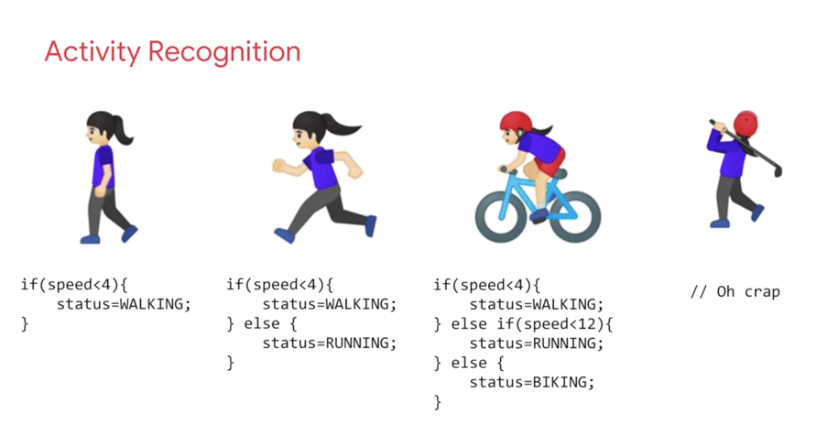
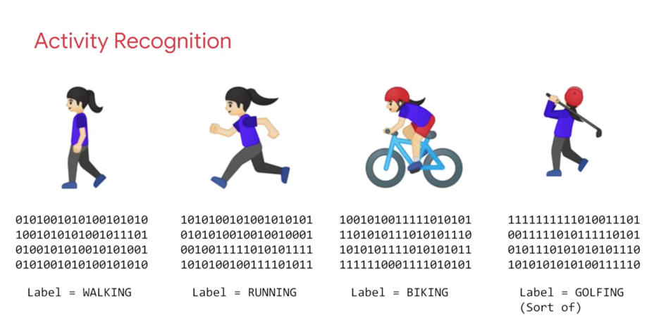
Applicability of machine learning
Notes:
Now, this is particularly valuable for problems that you can't solve by figuring the rules out for yourself. So consider this example, activity recognition. If I'm building a device that detects if somebody is say walking and I have data about their speed, I might write code like this and if they're running well that's a faster speed so I could adapt my code to this and if they're biking, well that's not too bad either. I can adapt my code like this. But then I have to do golf recognition too, now my concept becomes broken. But not only that, doing it by speed alone of course is quite naive. We walk and run at different speeds uphill and downhill and other people walk and run at different speeds to us. So, let's go back
to this diagram. Ultimately machine learning is very similar but we're just flipping the axes. So instead of me trying to express the problem as rules when often that isn't even possible, I'll have to compromise. The new paradigm is that I get lots and lots of examples and then I have labels on those
examples and I use the data to say this is what walking looks like, this is what running looks like, this is what biking looks like and yes, even this is what golfing looks like. So, then it becomes answers and data in with rules being inferred by the machine. A machine learning algorithm then figures out the specific patterns in each set of data that determines the distinctiveness of each. That's what's so powerful and exciting about this programming paradigm.
It's more than just a new way of doing the same old thing. It opens up new possibilities that were infeasible to do before. So in the next few minutes, I'm going to show you the basics of creating a neural network which is the workhorse of doing this type of pattern recognition. A neural network is just a slightly more advanced implementation of machine learning and we call that deep learning. But fortunately it's
actually very easy to code. So, we're just going to jump straight into deep learning. We'll start with a simple one and then we'll move on to one that does computer vision in about 10 lines of code. But let's start with a verysimple "Hello World" example. So you can see just how everything hangs together.

Slide 7
deep learning
Neural Networks

Slide 8
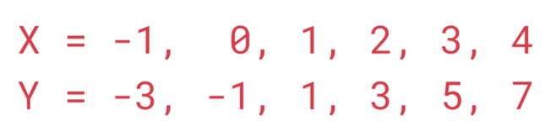
Can you figure out the formula?
y=2x-1
Notes:
Slide 7 - Can you figure out the formula?
Earlier I mentioned that machine learning is all about a computer learning the patterns that distinguish things. Like for activity recognition, it was the pattern of walking, running and biking
that can be learned from various sensors on a device. To show how that works, let's take a look at a set of numbers and see if you can determine the pattern between them. Okay, here are the numbers. There's a formula
that maps X to Y. Can you spot it? Take a moment.
Well, the answer is Y equals 2X minus 1. So whenever you see a Y, it's twice the corresponding X minus 1. If you figured it out for yourself, well done, but how did you do that? How would you think you could figure this out? Maybe you can see that the Y increases by 2 every time the X increases by 1. So it probably looks like Y equals 2X plus or minus something. Then when you saw X equals 0 and Y equals minus 1, so you thought hey that the something is a minus 1, so the answer might be Y equals 2X minus 1. You probably tried that out with a couple of other values and see that it fits.
Congratulations, you've just done the basics of machine learning in your head.

Slide 9
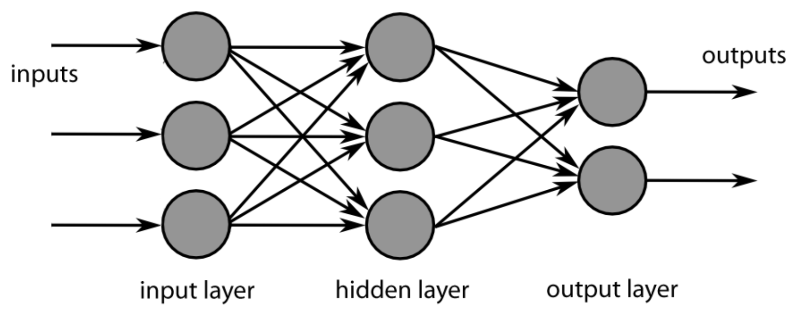
Feed Forward Neural network
Feed Forward Neural Network is a network of simple state machines called neurons or nodes which receive input, change their internal state according to that input and an associated weight to produce an output.
The nodes are grouped together in a ordered sequence of so called layers, and each node in layer is connected to all nodes in the next layer. Each node performs calculation which takes input from all nodes from previous layer.
Neural Nets has two modes of operation: training mode and prediction mode. In the training mode the network adjusts internal weights in order to minimize prediction error. In the prediction mode the trained network attempts to predict output for the given input.
One of the most striking facts about neural networks is that they can approximate any function given enough time and/or training data – universality theorem of neural networks

Slide 10
the network learns using loss functions & optimizers
A neural network learns by trial and error. It starts with a guess and checks the answer using the loss function. The error/loss function tells the neural network how far out its result is from the actual result based on the training data. The lower the loss, the closer the answer is to the actual result. By iterating over the training data and over again till the loss is smaller, the network learns the right answer.
The mathematical procedure for finding the minimum of the error/loss function is known as the optimization method or optimizer. The error is calculated as the difference between the actual output and the predicted output and the function that is used to compute this error is known as Loss function, mathematically J(w) = ao – po

Slide 11
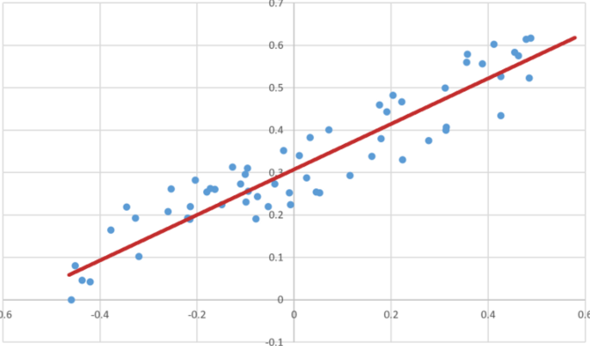
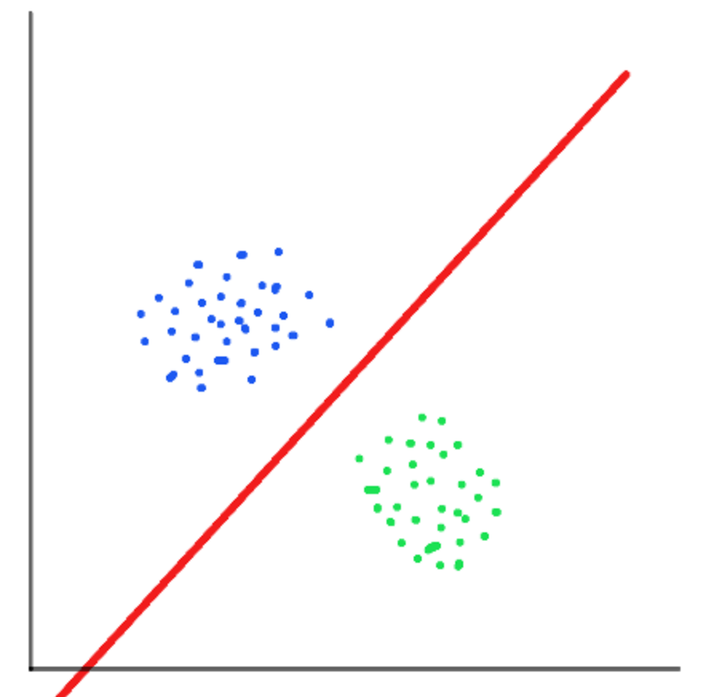
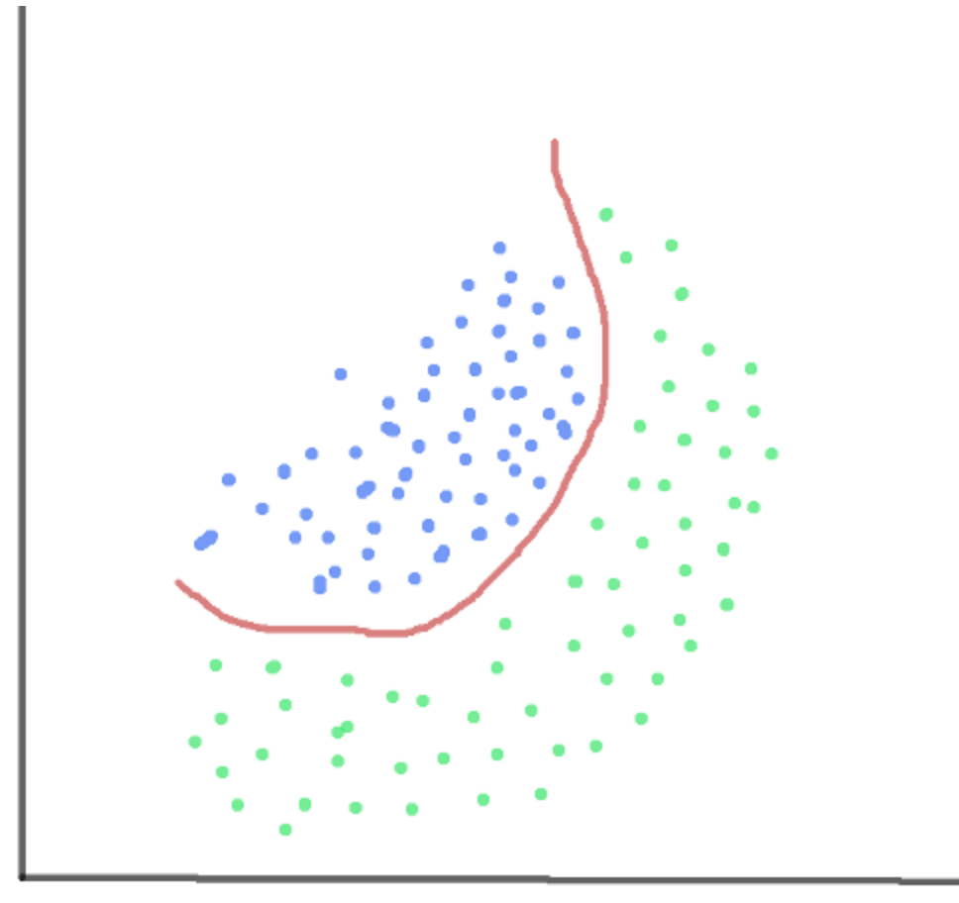
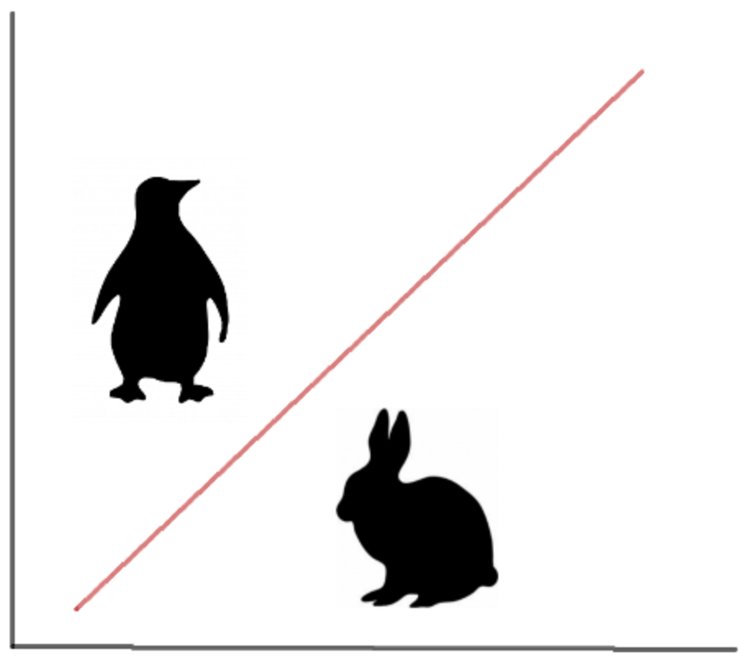
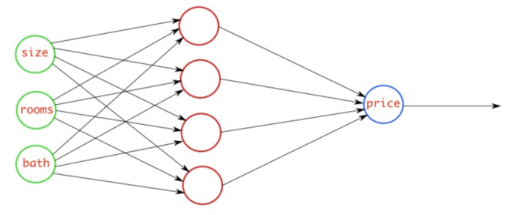
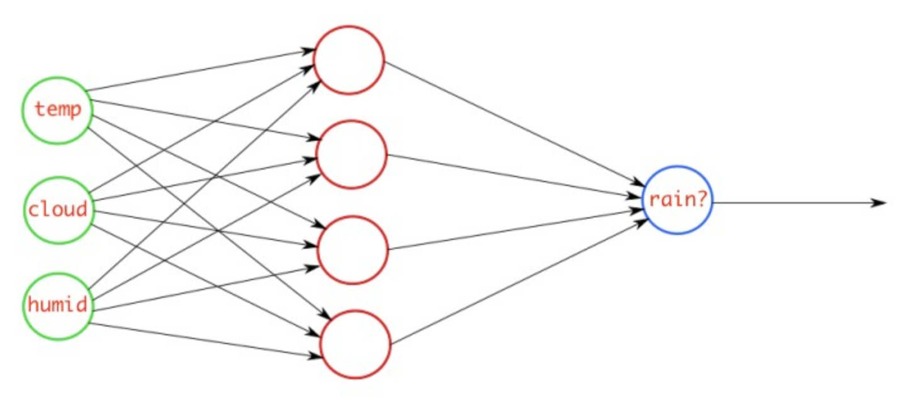
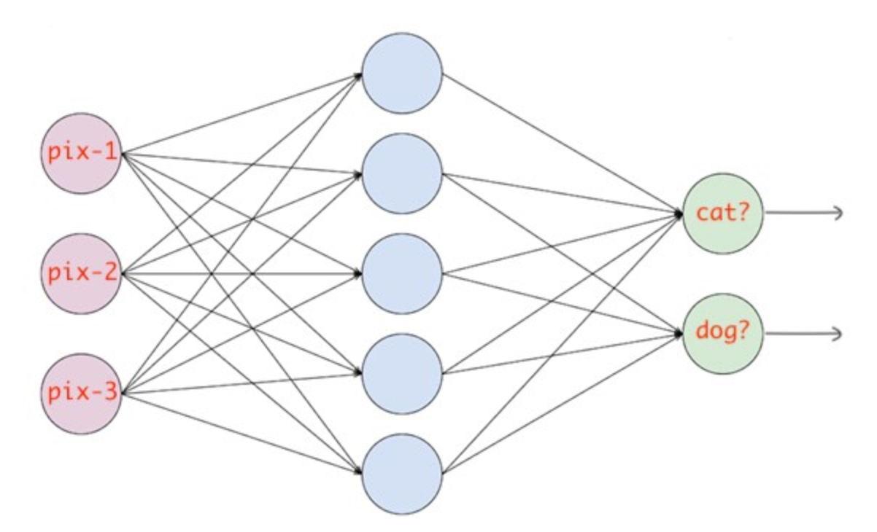
Understanding loss functions for neural nets
Mean Squared Error (MSE) – Mainly used for linear regression tasks where the output is a real number, this loss function uses the mean of squared differences between actual values and predicted values.
Binary Cross Entropy (BCE) – Mainly used for logistic regression or binary classification tasks when you want the neural network to classify the data into two classes (0 or 1) using Sigmoid function.
Categorical Cross Entropy (CCE) – Mainly used for multi-class classification tasks when you want the neural network to classify the data into multiple classes using Softmax function.
Predicting house prices based on property attributes
Predicting rain based on other measurable weather conditions
Predicting type of animal using images
Notes:
Linear Regression Linear regression is a very basic type of supervised machine learning, which tries to find the best possible straight line to describe main trend in underlying training data. Starting from some random position, it adjusts/moves the line until it finds the position that gives the minimum total average distance of data points from the line. It uses MEAN SQUARED ERROR (MSE) as a loss function and STOCHASTIC GRADIENT DESCENT (SGD) as an optimization algorithm. Stochastic gradient descent optimization method knows how to move line into direction which will likely lower the error. In its basic form, for one input x, and one output y, the model of this algorithm is basic mathematical formula for straight line y=k*x+n and training comes down to figuring out parameters k and n. The same procedure can be applied to problems with multiple inputs.
Logistic Regression
Logistic regression is a basic binary (yes/no) classification algorithm, that works in a same way as linear regression, just instead of adjusting straight line, it adjusts so called SIGMOID function. The output of a logistic regression is probability that given input belongs to some category (eg. spam/not spam, fraud/not fraud). Although Mean Squared Error can be used as a loss function, good practice is to use another type of loss functions called CROSS ENTROPY, which are better suited for classification problems. The basic principle is same: it uses optimization method to find values for parameters of sigmoid function that give the minimum of the loss function (prediction error for the given data set).
Convolutional Neural Network
Convolutional neural networks are neural networks specialized for image recognition tasks. You can think of them as a Feed Forward Networks with trainable image filters in front. These image filters perform photoshop-like image filtering (in so called convolutional layers) and resizing (in pooling layers). These image filters (also known as kernels) are able to learn to extract, and recognize patterns from input image. Convolutional networks can be used for visual recognition tasks like image classification and object detection.

Slide 12
Building A single neuron Neural network
A Neural Network is a set of functions which can learn patterns. The simplest possible neural network is one that has only one neuron in it. Let us look at an example:
This is written using Python and TensorFlow and an API in TensorFlow called Keras. Keras makes it really easy to define neural networks. In Keras, you use the function dense to define a layer of connected neurons.
There's only one dense here. So there's only one layer and there's only one unit in it, so it's a single neuron. Successive layers are defined in sequence, hence the word sequential.
You define the shape of what's input to the neural network in the first and in this case the only layer, and you can see that our input shape is just one value.
Notes:
So let's take a look at it in code now. Okay, here is our first line of code. This is written using Python and TensorFlow and an API in TensorFlow called keras. Keras makes it really easy to define neural networks. A neural network
is basically a set of functions which can learn patterns. Don't worry if there were a lot of new concepts here. They will become clear quite quickly as you work through them.
The simplest possible neural network is one that has only one neuron in it, and that's what this line of code does. In keras, you use the word dense to define a layer of connected neurons. There's only one dense here. So there's only one layer and there's only one unit in it, so it's a single neuron. Successive layers are defined in sequence, hence the word sequential. But as I've said, there's only one. So you have a single neuron. You define the shape
of what's input to the neural network in the first and in this case the only layer, and you can see that our input shape is super simple. It's just one value.

Slide 13
Building A single neuron Neural network – Loss & Optimizer
The neural network has no idea of the relationship between X and Y, so it makes a guess. Say it guesses Y equals 10X minus 10. It will then use the data that it knows about, that's the set of Xs and Ys that we've already seen to measure how good or how bad its guess was.
The loss function measures this and then gives the data to the optimizer which figures out the next guess.
The optimizer ensures that each guess is better than the one before. As the guesses get better and better, the accuracy approaches 100 percent where loss is closer to zero.
In this case, the loss is mean squared error and the optimizer is SGD which stands for stochastic gradient descent.
Notes:
You've probably seen that for machine learning, you need to know and use a lot of math, calculus probability and the like. It's really good to understand that as you want to optimize your models but the nice thing for now about TensorFlow and keras is that a lot of that math is implemented for you in functions. There are two function roles that you should be aware of though and these are loss functions and optimizers. This code defines them. I like to think about it this way. The neural network has no idea of the relationship between X and Y, so it makes a guess. Say it guesses Y equals 10X minus 10. It will then use the data that it knows about, that's the set of Xs and Ys that we've already seen to measure how good orhow bad its guess was. The loss function measures this and then gives the data to the optimizer which figures out the next guess. So the optimizer thinks about how good or how badly the guess was done using the data from the loss function. Then the logic is that each guess should be better than the one before. As the guesses get better and better, an accuracy approaches 100 percent, the term convergence is used. In this case, the loss is mean squared error and the optimizer is SGD which stands for stochastic gradient descent.

Slide 14
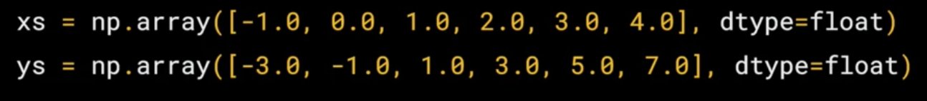
Building A single neuron Neural network - Train
Our next step is to represent the known data. These are the Xs and the Ys that you saw earlier.
The np.array is using a Python library called numpy that makes data representation easier.
Here we have one list for the Xs and another one for the Ys.
The training takes place in the fit command. Here we're asking the model to figure out how to fit the X values to the Y values. The epochs equals 500 value means that it will go through the training loop 500 times.
This training loop is what I described earlier. Make a guess, measure how good or how bad the guesses with the loss function, then use the optimizer and the data to make another guess and repeat this.
When the model has finished training, it will then give you back values using the predict method. So it hasn't previously seen 10, and what do you think it will return when you pass it a 10? Why?
Code is at: http://bit.ly/nnhello
Notes:
Our next step is to represent the known data. These are the Xs and the Ys that you saw earlier. The np.array is using a Python library called numpy that makes data representation particularly much easier. So here you can see we have one list for the Xs and another one for the Ys.
The training takes place in the fit command. Here we're asking the model to figure out how to fit the X values to the Y values. The epochs equals 500 value means that it will go through the training loop 500 times. This training loop is what we described earlier. Make a guess, measure how good or how bad the guesses with the loss function, then use the optimizer and the data to make another guess and repeat this. When the model has finished training, it will then give you back values using the predict method. So it hasn't previously seen 10, and what do you think it will return when you pass it a 10? Now you might think
it would return 19 because after all Y equals 2X minus 1, and you think it should be 19. But when you try this in the workbook yourself, you'll see that it will return a value very close to 19 but not exactly 19. Now why do you think that would be?
Ultimately there are two main reasons. The first is that you trained it using very little data. There's only six points. Those six points are linear but there's no guarantee that for every X, the relationship will be Y equals 2X minus 1. There's a very high probability that Y equals 19 for X equals 10, but the neural network isn't positive. So it will figure out a realistic value for Y. That's the second main reason. When using neural networks, as they try to figure out the answers for everything, they deal in probability.

Slide 15
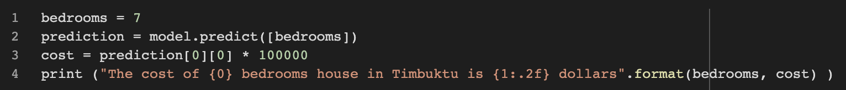
Simple Neural Net for House Price Prediction
Let us now create a simple neural network to predict the price of a house according to a simple formula:
If house pricing was as easy as a house costs 50k + 50k per bedroom, so that a 1 bedroom house costs 100k, a 2 bedroom house costs 150k etc. ie.,Cost = 50 + bedrooms * 50
Let us create a simple one neuron neural network that learns this relationship so that it would predict a 7 bedroom house as costing close to 400k etc. Our input is:
A simple one-neuron neural network model using Keras is as follows:
Train the model for 500 epochs:
With the training complete, use the model top predict the price of a 7 bedroom house
Code is at: http://bit.ly/hpprediction

Slide 16

Tinker with a NEURAL NETWORK in REAL-TIME
Deep playground is an interactive visualization of neural networks located at https://playground.tensorflow.org
It has four datasets with two input features and one output label. The two input features are represented by the coordinates X1 in the horizontal axis and X2 in the vertical axis. The output label is the color of the dots, blue (+1) or orange (-1).
When you click the play button it is actually training a neural network that runs in your browser. The background color of the output changes from light shades (representing 0) to blue and orange patterns that illustrate what the network will predict for new input.
Circle dataset solved
in 100 Epochs
Two cluster dataset solved
in 74 Epochs
Four quadrant dataset
solved in 111 Epochs
Swirl dataset does not
converge even after
3500 Epochs
So how can we get the swirl dataset to converge on a solution?

Slide 17
Feature engineering to the rescue
One way is to do feature engineering. Add new input features. You take the input features and square them, multiply them together, take sin and cos and feed them into a shallow neural network. This represents Transformation in classical feature engineering.
By adding multiple features on top of existing data set, we are able to see convergence in less than 1000 epochs
In machine learning a series of predictor variables that contain data believed to be predictive of the outcome variable are called features.
Feature engineering refers to a process of selecting and transforming these predictor variables when creating a predictive model. The process also called pre-processing involves a combination of data analysis, applying rules of thumb, and judgement.
For example, in a model predicting property prices, the data showing the actual prices is the outcome variable. The data showing things, such as the size of the house, number of bedrooms, and location, are the predictor variables. These are believed to determine the value of the property.
Feature Engineering is an art more than a science

Slide 18
The Deep Learning Approach
Another approach is to use deep learning. You don’t cleverly manipulate the input features (a process that gets much more difficult on less trivial examples). You simply only use the raw inputs, X1 and X2. But you add more layers.
This deep layer neural network converges on the swirl dataset with only X1 and X2 features in 333 epochs
In this setup, we have six hidden layers, set the regularization to L2 with a rate of 0.001 and activation is set to ReLU.
We then start with the raw input and have multiple layers of increasing abstraction. You can see the first layer of neurons have simple patterns that detect boundaries. They mostly cut the background in half at various degrees of rotation. Then as you look to the right the patterns are more complicated.
The first layers detect edges, the middle layers detect circles from the edges, and the last layers detect swirls from the circles.

Slide 19
OVERFITTING in deep learning
One of the most important aspects when training neural networks is avoiding overfitting.
Overfitting refers to the phenomenon where a neural network models the training data very well but fails when it sees new data from the same problem domain. Overfitting is caused by noise in the training data that the neural network picks up during training and learns it as an underlying concept of the data.
This learned noise, however, is unique to each training set. As soon as the model sees new data from the same problem domain, but that does not contain this noise, the performance of the neural network gets much worse.
Overfitting increases with network complexity – the deeper the layers, the network is said to be more complex.
Less complex neural networks are less susceptible to overfitting. To prevent overfitting or a high variance we must use something that is called regularization
Overfitting increases with network complexity

Slide 20
Regularization in deep learning
Regularization refers to a set of different techniques that lower the complexity of a neural network model during training, and thus prevent the overfitting.
There are three very popular and efficient regularization techniques called L1, L2, and dropout.
The L2 regularization is the most common type of all regularization techniques and is also commonly known as weight decay or Ride Regression.
In L2 regularization, the weights of the neurons in the network is made a little bit smaller each time an update is performed during the training so that it approaches zero (but not zero), whereas, in L1 regularization the weights of the neurons is reduced so that some of the neurons weight are made zero.
The factor used for increasing or decreasing regularization is alpha
Aggressive regularization runs the risk of underfitting the data

Slide 21
deep learning
IMAGE RECOGNITON WITH NEURAL NETWORKS - TEASER

Slide 22
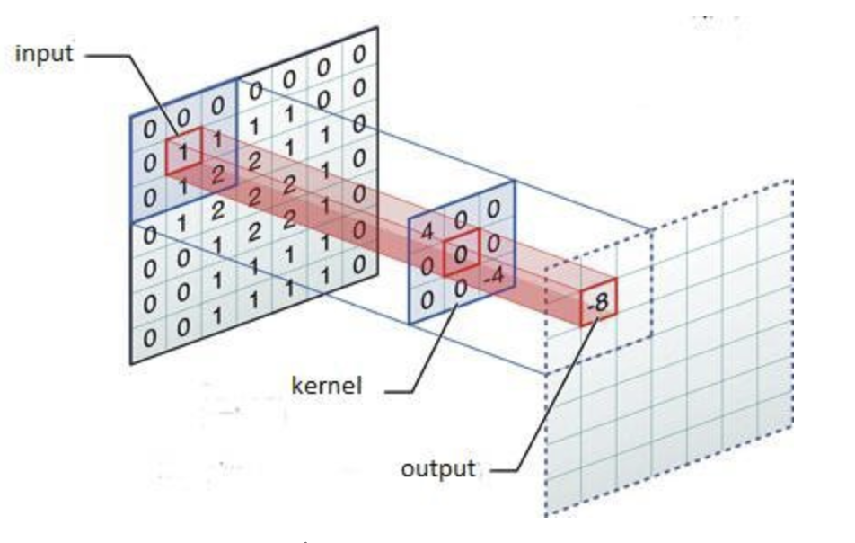
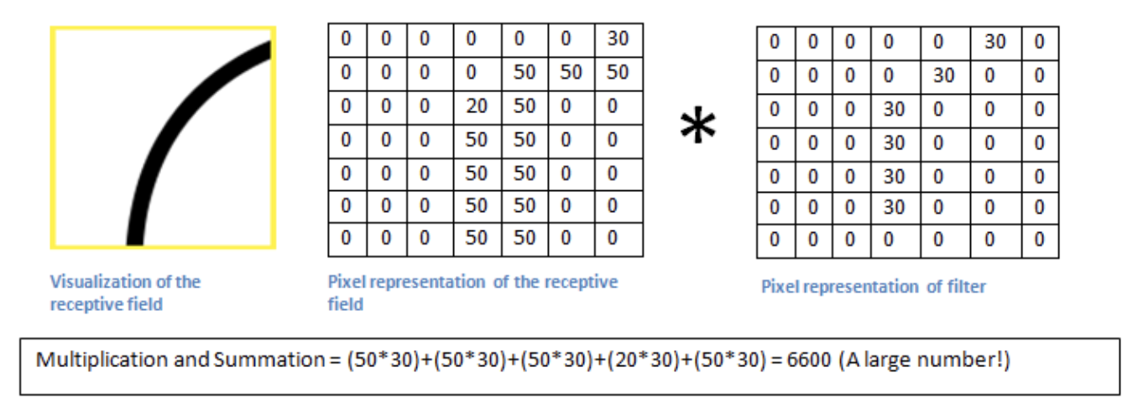
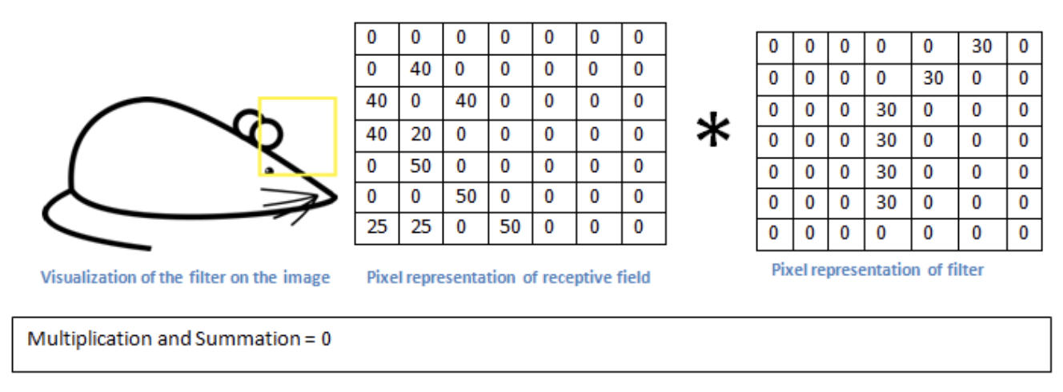
Convolutions in neural networks
CNN’s make use of filters (also known as kernels), to detect what features, such as edges, are present throughout an image.
A filter is just a matrix of values, called weights, that are trained to detect specific features. The filter moves over each part of the image to check if the feature it is meant to detect is present. To provide a value representing how confident it is that a specific feature is present, the filter carries out a convolution operation, which is an element-wise product and sum between two matrices.
When the feature is present in part of an image, the convolution operation between the filter and that part of the image results in a real number with a high value. If the feature is not present, the resulting value is low.

Slide 23
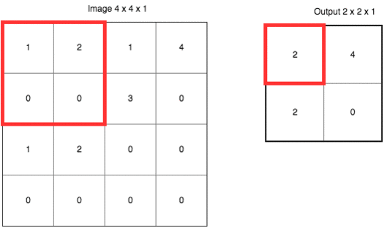
DOWNSAMPLING in CNNs
To speed up the training process and reduce the amount of memory consumed by the network, we try to reduce the redundancy present in the input feature.
The most common way to down sample an image is Max Pooling. In max pooling, a window passes over an image according to a set stride (how many units to move on each pass). At each step, the maximum value within the window is pooled into an output matrix, hence the name max pooling.
In the following visual, a window of size f=2 passes over an image with a stride of 2. f denotes the dimensions of the max pooling window (red box) and s denotes the number of units the window moves in the x and y-direction. At each step, the maximum value within the window is chosen.
Max pooling significantly reduces the representation size, in turn reducing the amount of memory required and the number of operations performed later in the network.

Slide 24
Classifying cats and dogs using neural networks
Let us train a CNN on a data set of cats and dogs images.
The code is at: http://bit.ly/nncatsdogs

